Slide 1
Final Presentation
Home Advantage in Football
A presentation by
Anastasia Hildebrandt
Alexander Kens
Raphael Kleemann Sánchez
Florian Six
TU Berlin
WiSe 2021/22
Programming Project:
Data Science in Python and R
Group D
Notes:
Welcome! We will be talking about Home Advantage in Football.

Slide 2
TABLE OF CONTENTS
01
Motivation
02
Data Sources
Results
03
Method
04
05
Conclusion
Why do we care?
Where is the data?
What approach is used?
Drumroll please!
What to take away.
Notes:
We structured our presentation in 5 chapters going from the introduction over to data, our methods and in the end our results and conclusion.

Slide 3
01
Motivation
Why do we care?
Notes:
Let’s first talk about the term Home Advantage.

Slide 4




Notes:
HA, also called home ground- or home field-advantage describes the benefit that the home team is said to gain over the visiting team. It exists in many sports and especially in football it’s considered an integral part of the culture.

Slide 5
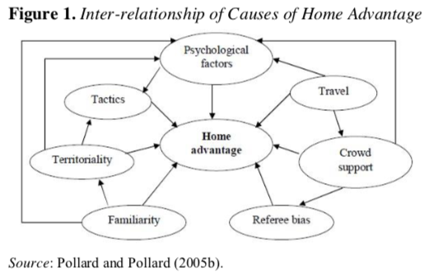
Home Advantage
Alan M. Nevill and Roger L. Holder - 4 main reasons (1):
Crowd
Learning
Travel
Rule factors
Richard Pollard - 10 possible reasons:
Crowd Effects, Travel Effects, Familiarity, Referee Bias, Territoriality, Special Tactics, Rule Factors, Psychological Factors, Interaction of Causes (2)
(3)
(4)
Notes:
There are many factors which contribute to HA and a lot of theories which try to describe HA but academically it is still an unresolved puzzle in many ways.
What we can do for sure though is to measure.

Slide 6


Let’s Measure
1965 Away Goals Rule
Notes:
And Measure it will be. But before we do I tell you a little story about HA.
Back in the 60s HA was also already around, so the UEFA, the Union of European Football Associations, wanted to fight it. And that is why 1965 they introduced the Away Goals Rule.
And surely the Uefa measured the HA back then, right?

Slide 7

Let’s not Measure
1965 Away Goals Rule
Notes:
But they didn’t.
So because it just was considered unfair and very hard to achieve Away Goals the UEFA introduced the Away Goals Rule.

Slide 8
Away goals rule
When 2 teams play each other twice, once at each team’s home ground and it is a tie score wise, the team which scores more ‘away goals’, wins. (4)
Home Team | Away Team | Score | Away Goals A | Away Goals B
Team A | Team B | 1:1 | X | 1
Team B | Team A | 0:0 | 0 | X
Winner → Team B
Notes:
Away Goals Rule:
When 2 teams play each other twice, once at each team’s home ground and it is a tie score wise, the team which scores more ‘away goals’, wins. (4)
And this should mitigate the HA.

Slide 9
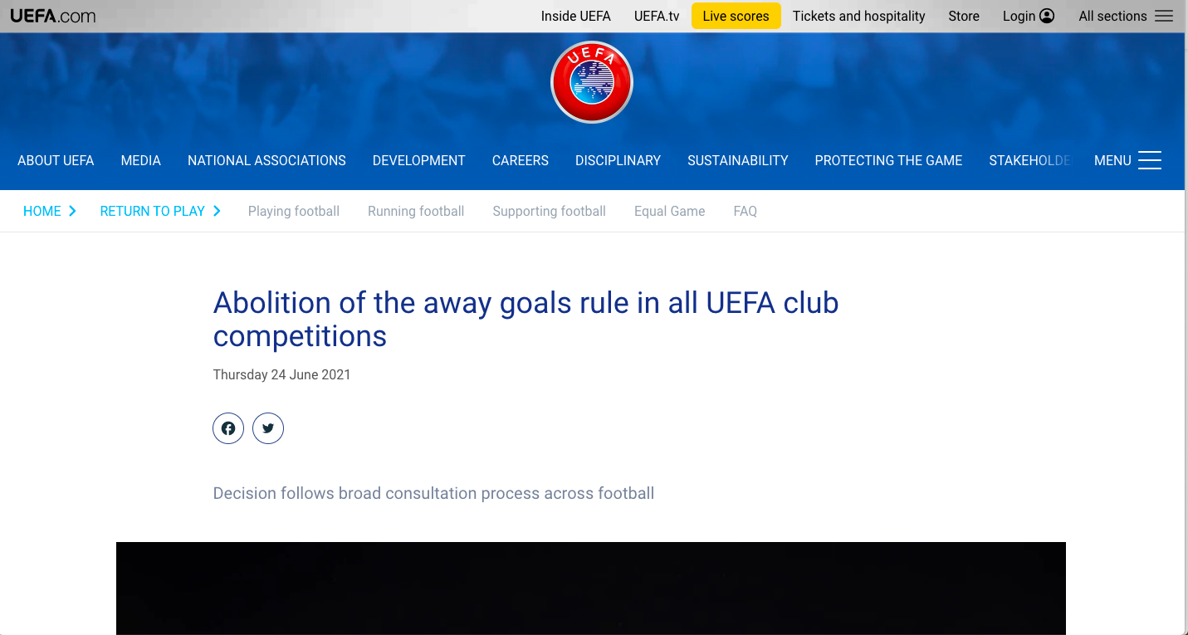
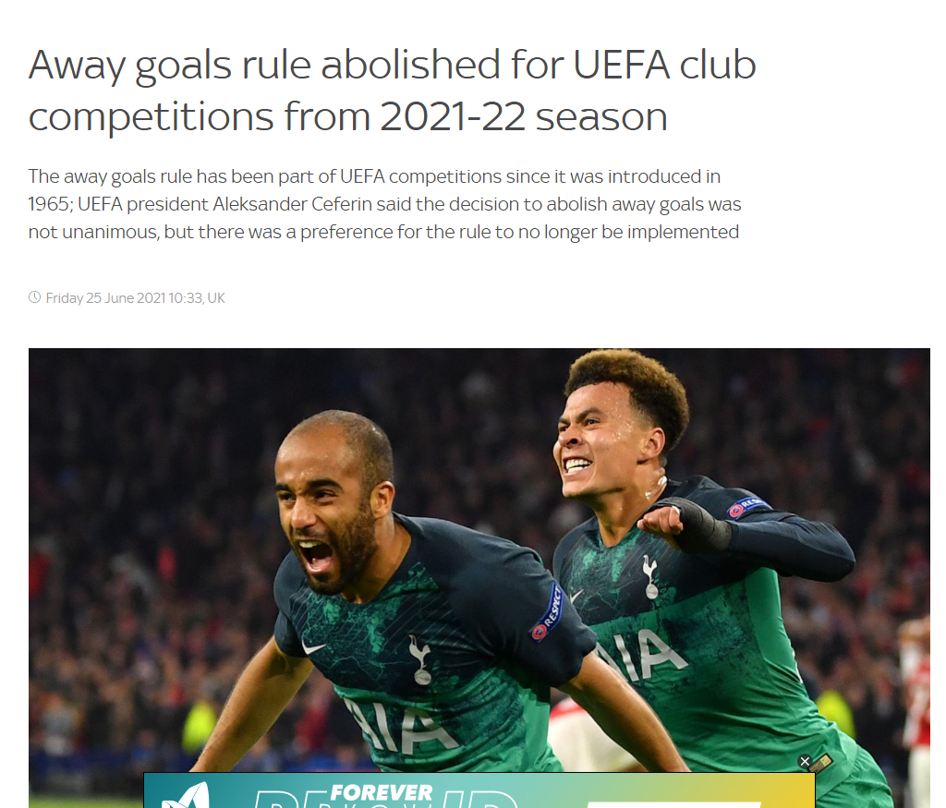
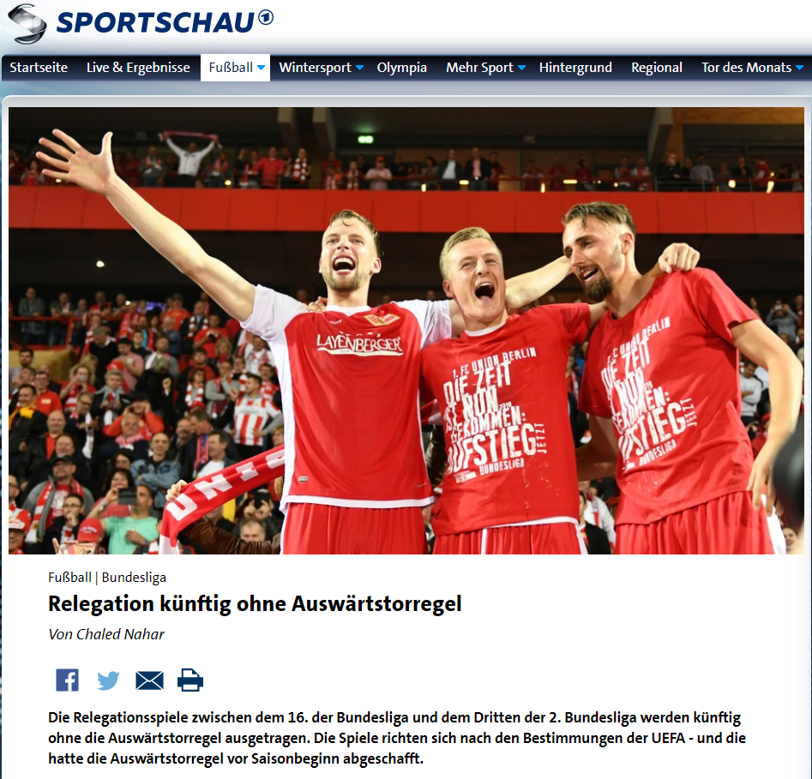
(5)
(6)
(7)
Notes:
Now about 60 years later in 2021 the UEFA abolished the Away Goals Rule. A big step for the respective leagues and the German Bundesliga followed this call of justice.
The rule is based on the existence of HA and now it does not exists anymore? Or was the rule from the beginning a bogus idea?
They followed the recommendation of the UEFA Club Competitions Committee and the UEFA Women’s Football Committee.
But what reasons did they have to propose this?

Slide 10
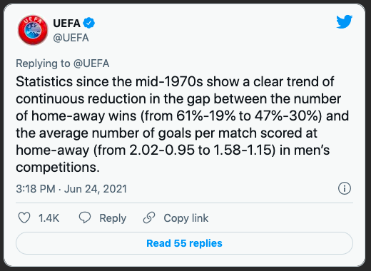
UEFA
UEFA President Aleksander Čeferin:
“consistency across Europe in terms of styles of play, and many different factors which have led to a decline in home advantage”
(8)
Notes:
In order to explain this decision the president himself commented on the matter:
“many coaches, fans and other stakeholders have questioned its fairness and have expressed a preference for the rule to be abolished.”
“consistency across Europe in terms of styles of play, and many different factors which have led to a decline in home advantage”
Ah, Interesting, he even mentions ha by name.
And they also released a Tweet which even comes with some numbers.
So statistics seem to show a downward trend of ha. from 61-19 to 47-30. And average goals per match…
Since I could not find out what data the UEFA used I hope we find some similarities especially for the 47%-30% ratio.
Btw data, let’s talk about our data first.

Slide 11
02
Data Sources
Where is the data?
Notes:
Where does our data comes from?

Slide 12
Research to Data Question
I. Construct
II. Construct
RQ: Does Home Advantage exist in professional European football?
DQ:
How many goals made
at home & away…
How many home wins made on average…
…in the first leagues of Germany, England,
Spain, Italy and France?
Notes:
As you have heared, we wanted to know if there is home advantage, due to the recent abolishment of the away goals rule thats why we stated an research question:
Does hw exist in pro football?
That we further unfold to get more surface and different perspectives on the same issue thats why we stated two data questions:
A: How many Home wins made on average
B: How many goals made at home and away
… int the first leauges of Germany, England, Spain, Itlay and FR?
Building a frame for what data we focus on.

Slide 13

API-Football.com
each League has its own folder with all the seasons from 2010 till 2020
Process:
API-Requests
→
Resources
→
Clean Data
Python
JSON
Dataframe
Notes:
To get the right amount of useful data to answer these questions :
We used the website API-Football.com as our source
Via an interface we can communicate and gatherwhat we need.
It holds all football relevant information since 2008, from countries leagues, over to their clubs till the scores of single matches
After a request the rescources are still coarse and unhandy, thats why we format it , ignoring what we dont need getting a clean table.

Slide 14
How does our Dataset look like?
Column heads:
25.000+ entries —> each represents data of a single match ( / fixture )
e.g. first game in Bundesliga 1 of Season 2010/2011:
Notes:
And Thats how you can imagine our dataset in the end:
Holding the specified national leagues we mentioned before
With more than 25.000 entries in total, each of these entries representing a single match
As an example here we have the first game of season 2010/11 in the Bundesliga
Showing that bayern munich was hosting wolfsburg and made a win at home scoring 2:1

Slide 15
03
Method
Approaching Home Advantage
Notes:
In this section we are going to tell you how we calculated Home Advantage

Slide 16
Metric - How do we calculate HA?
Host Team | Guest Team | Score
Hertha BSC | FC Bayern Munich | 2 : 0
Home Win = | Away Loss
FC Bayern Munich | Hertha BSC | 1 : 2
Home Loss = | Away Win
# home wins
home win rate =
# all games
all games = home wins + away wins + draws
Draws = Home Draws = Away Draws
Notes:
Imagine we as we are here in Berlin are part of Herthas Team and we invite Bayern as a guest
We play and we score 2 goals thus we score them at home and we speak of a home win
Next week we meet bayern at their stadium and bayern scores one goal and we as hertha score 2 goals
again we win but now we speak of an away win.
Also it could happen that we score equal, in case of a draw we can basically ignore where it happes if at home or away [due to the face that the counterpartie holds the relevant information]
So counting the wins made at home and away for each match plus the draws brings us to our metric to see if there is Home advantage.

Slide 17
04
Results
Drumroll please!
Notes:
Let’s come to the most interesting part. What are our actual results?

Slide 18
Data Questions
How many home games are won on average?
→ single league
→ all leagues
How many goals made at home/ away?
Notes:
We decided to approach our analysis from two point of views. First we wanted to see how many home games are won on average for a single league and later for all leagues and if there are any similarities we could see. The second approach was to look at how many goals were made at home and away and if we could see a similar trend going on here.

Slide 19
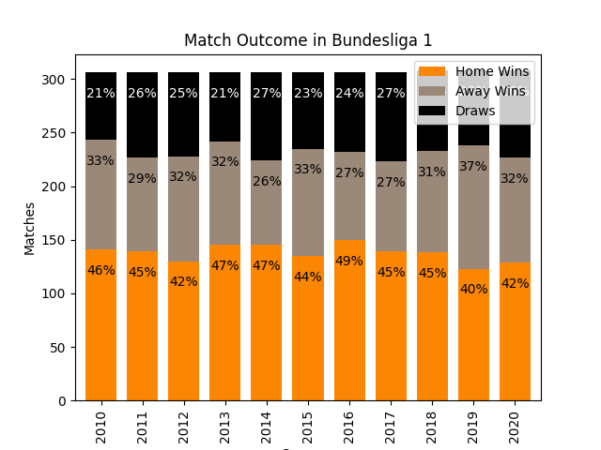
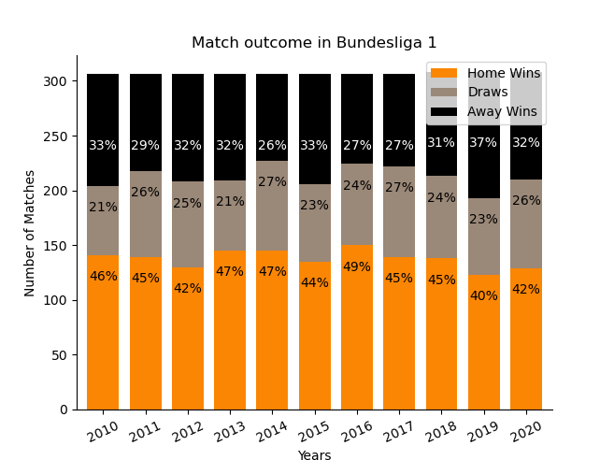
Match Outcome in a Single League
average away win rate: 31%
average draw rate: 24%
average home win rate: 44,7%
Notes:
Here you can see a stacked bar diagram with the match outcomes for bundesliga 1. On the x axes you can see the years ranging from 2010 until 2020. and on the y axes are the number of all matches. Bundesliga 1 had each year either 306 or 308 games.
At the bottom of the stacked bar diagram you can see the number of home wins in orange, in grey are the number of draws and in black are the away wins. We also included the rates in percent inside the bars so it is easier to identify the differences from year to year.
I think what everybody can see right away is that the number of home wins takes up the majority of outcomes. Even though it is not quite 50% but it is just below that with an average home win rate of 44,7%. The average away win rate however lies at 31% and is closely followed by the draw rate of 24%. You have seen the match outcomes for Bundesliga 1, but what about the rest?

Slide 20
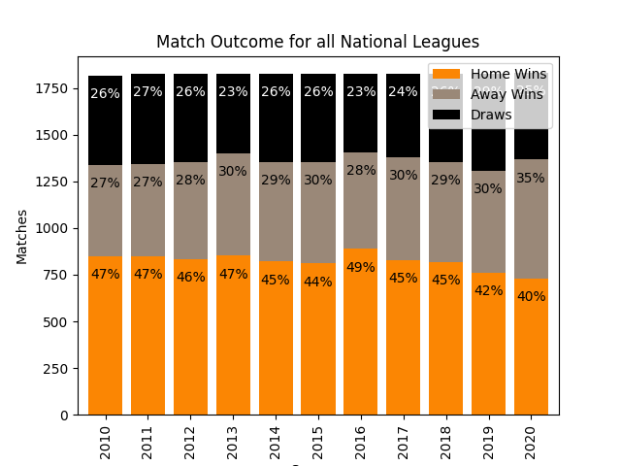
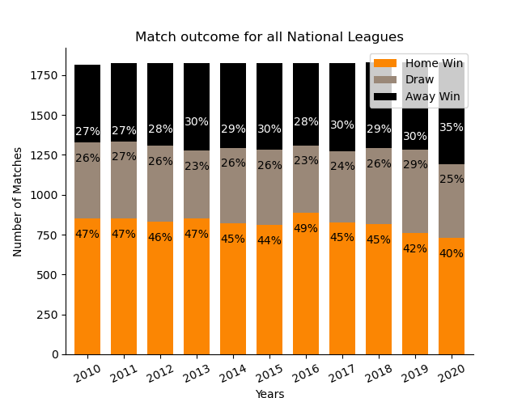
Match Outcome in all National Leagues
average away win rate: 29%
average draw rate: 25,5%
average home win rate: 45%
Notes:
Instead of showing you all the different leagues separately, we joined them all together. This stacked bar diagram has exactly the same structure as the diagram on the previous slide. So the years are on the x axis and the number of matches are on the y axis. Notice that the number of matches is much higher, because now all the games from all 5 leagues are included. The interesting thing you can observe here is that the average rates, which you can see on the side here, only have a 1% difference to the Bundesliga rates. But another thing we noticed is that if we ignore 2016, because for some reason all leagues scored super good in 2016. We have a small but steady decrease of home wins over the years. The home win rate started at 47% in 2010 and slowly decreased to 40% in 2020. Simultaneously the number of away wins got slightly bigger.

Slide 21
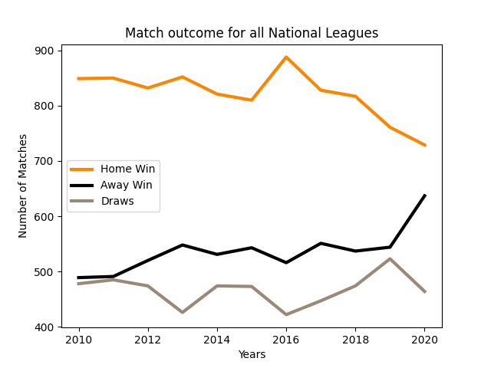
Match Outcome in all National Leagues
Season | HW | AW | Diff
2010 | 849 | 489 | 360
2020 | 729 | 637 | 92
→ drop of difference by 74,5%
Notes:
On this slide we wanted to show you how much the difference of home and away wins has changed. Here we have a line diagram with the years on the x axis and number of matches on the y axis. There were only 489 away wins in 2010 and almost double as much home wins. But if you look at 2020 the numbers have changed drastically. There are only 92 more home wins than away wins, which means the difference has dropped by 74,5% over the last 10 years.

Slide 22
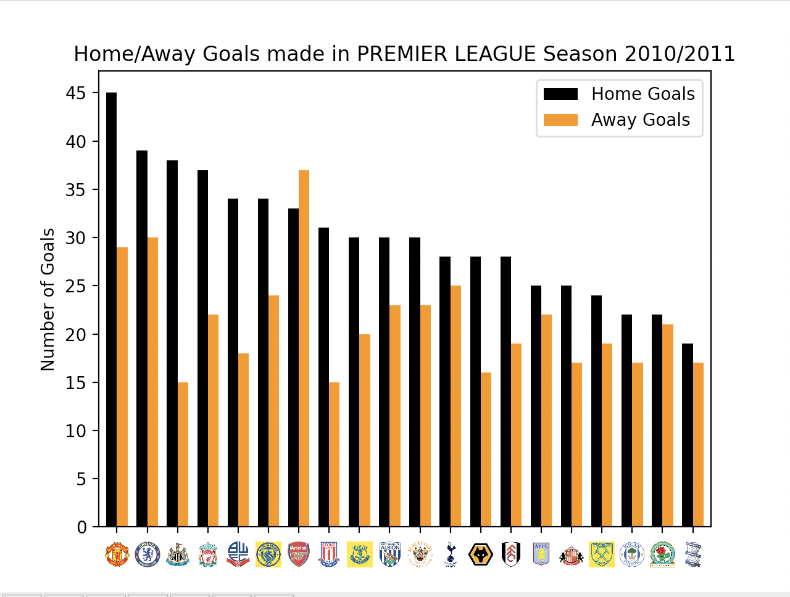
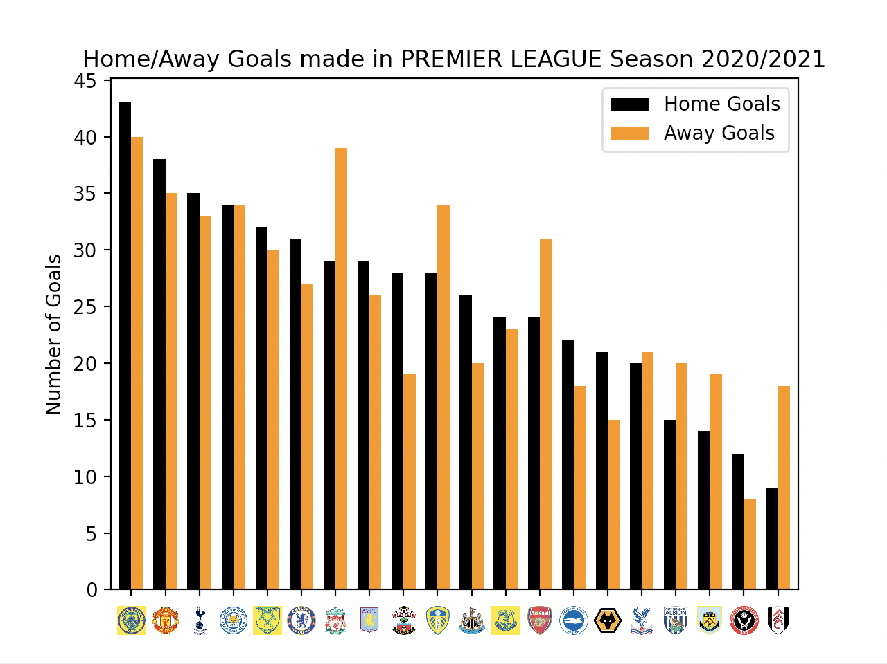
Goals made in a single League
big difference in terms of scoring at Home in 2010/2011
How much more do clubs really score at Home than they do Away?
Notes:
Ok so let’s talk about our second approach, where we analyse the number of goals a football club makes at home and away. On this slide you can see two graphs each one showing for every club in the premier league for a particular season how many goals were made. The black bar is the number of goals at home and the orange bar shows how many goals the club has made on away turf. As a first observation i think one can definitely say that on the left hand side for season 2010/2011 there seems to be a big difference in terms of scoring at home. Lets take Manchester United as an example. They have scored 45 goals at home whereas scoring just about 30 goals away. Thats a difference of over 15 goals more made at home. In generell we only have one club, arsenal, that has scored more goals away than they did at home. For the other clubs the gap between home goals and away goals is pretty big. Something we can not say when having look at the graph on the right side for season 2020/2021. This season 7 clubs have scored more away than at home, and in generell the gaps are in no way as big as in season 2010-2011, the maximum difference in home goals and away goals is for southhampton scoring about 10 goals more at home. This observation has led us to ask ourselves, ok so, how much more do clubs really score at home than they do away? In order to answer this question we thought of computing the average difference in home goals and away goals and plotting it for every season to display a change over the years. We can see that on the following slide.

Slide 23
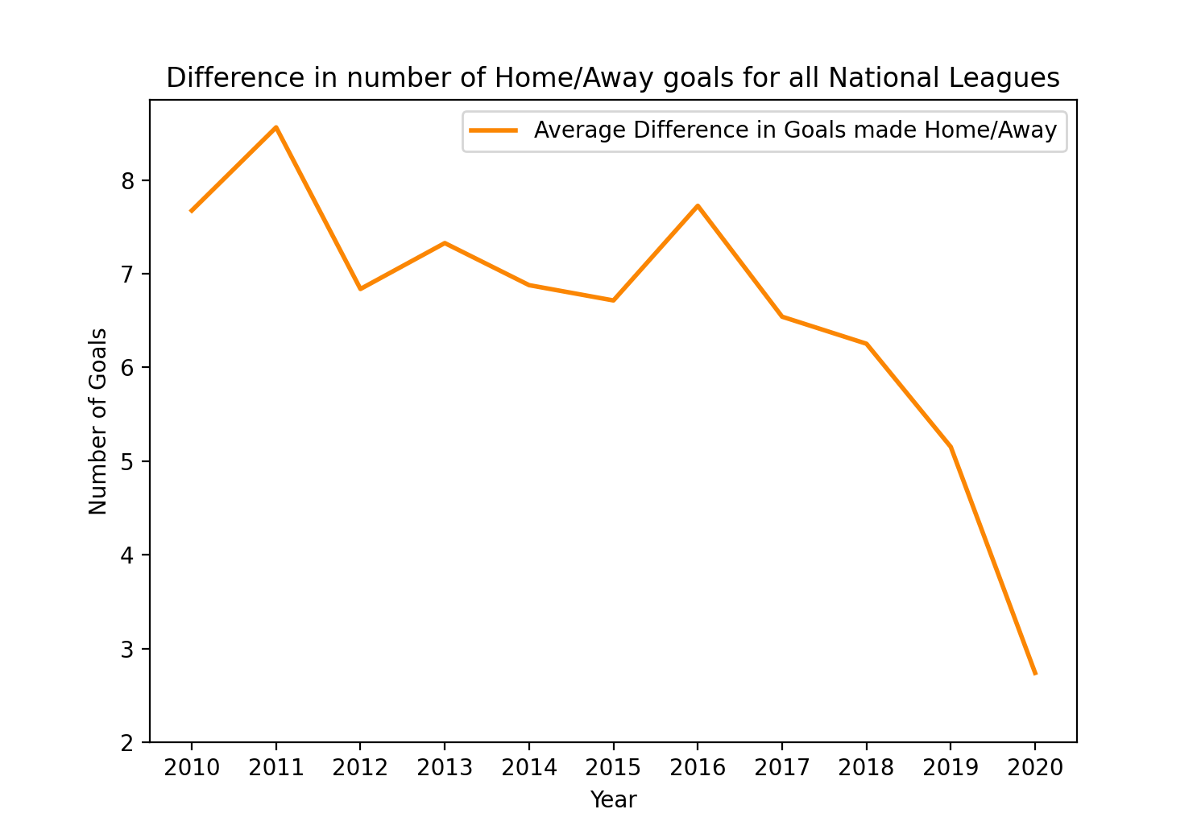
Goals made in all National Leagues
2011: 8-9 more goals at home than away
decreases continuously since 2017
big drop in 2020
2020: 2-3 more goals at home than away
still more goals at home, but a significant decline is noticeable!
Notes:
This graph shows the difference in number of home/away goals for all national leagues from 2010 up until 2020. Basically it is the difference we have seen on the previous slide on an average over all national leagues for every season. So what does it say? A football club in the year 2010, on an average, has scored almost 8 goals more at home than they have scored away. We can see a peek in the year 2011, where a football club has scored almost 9 home goals more than away goals. Starting in 2017, eventually there is a decrease, with a big drop in 2020 where a football club has scored 2-3 more goals at home than away. So what can we take away from this graph? Clearly, football clubs still score more goals at home. We can not deny that. But what is also clearly to see, is that there is a significant decline. As of the numbers we have on current seasons, having very special conditions due to covid regulations. The home advantage does get smaller indeed, nevertheless still being present throughout all national leagues. Lets go onto our conclusion.

Slide 24
05
Conclusion
What to take away.
Notes:
What to take away.

Slide 25
Takeaways
UEFA President Aleksander Čeferin:
- “decline in home advantage”
- our findings 45%-29% for top 5 national leagues for the seasons from 2010/11 till 2020/21
- 2010: 8 more home-goals
- 2020: 3 more home-goals
Notes:
All in all there is still HA. No doubt.
Except one time in La Liga the Home Wins are always the highest portion.
Did we experience a decline in HA in the last 10 years, how Aleksander Ceferin commented? Definitively!
Our findings show a home-win ratio of 45%-29% which is pretty close to the numbers of the UEFA. Since our Data-sets probably differ it is very surprising that they match. And this also means that a lot of leagues experience the same trend in HA decline, not just the ones we have been analyzing.
The goals also paint a pretty clear picture. From away-goal rates in 2010 which were always lower and if higher considered outliers, they now in 2020 are quite normal. But still 3 home-goals more than away-goals are still higher but part of the decline which started in 2010 with 8 home-goals more.
ssaasa

Slide 26
Takeaways
there is still Home Advantage but it is becoming less significant
2020: Home-Away-Draw-Wins → 40-35-25 %
UEFA was right abolishing the Away Goals Rule
Notes:
But to conclude there is still HA though. It is not vanished yet.
Because in 2020 home-wins with 40% are still the biggest factor next to away-wins and draws.
It seems the UEFA was right abolishing the Away Goals Rule because without a significant HA this rule can’t be upheld. So we kinda approve this decision. (like we have any say in this)
ssaasa

Slide 27
Thank You! Any Questions?
Notes:
We hope you enjoyed our final presentation. Thank you for your attention and are there any questions so far?

Slide 28
Sources
Papers:
(1) Nevill, A.M. and Holder, R.L., 1999. Home advantage in sport. Sports Medicine, 28(4), pp.221-236.
(2) Pollard, R., 2008. Home advantage in football: A current review of an unsolved puzzle. The open sports sciences journal, 1(1).
Pictures/Screenshots:
(3) Carron, A.V., Loughhead, T.M. and Bray, S.R., 2005. The home advantage in sport competitions: Courneya and Carron's (1992) conceptual framework a decade later. Journal of sports sciences, 23(4), pp.395-407.
(4) Pollard, R., 2008. Home advantage in football: A current review of an unsolved puzzle. The open sports sciences journal, 1(1), pp.12-14.
(5) https://www.skysports.com/football/news/11095/12340830/away-goals-rule-abolished-for-uefa-competitions-from-2021-22-season
(6) https://www.uefa.com/returntoplay/news/026a-1298aeb73a7a-5b64cb68d920-1000--abolition-of-away-goals-rule-in-all-uefa-club-competitions/
(7) https://www.sportschau.de/fussball/bundesliga/dfl-relegation-bundesliga-ohne-auswaertstorregel-100.html
(8) https://www.goal.com/en/news/away-goals-rule-what-is-it-will-uefa-drop-from-champions/c8h61pd7sm916zulqe11ug53
(9) https://www.api-football.com/
Pictograms:
https://www.flaticon.com
- All screenshots and web sources were taken or visited in 10.02.2022

